Slide 1
Teaching Out-of-Order Processor Design with the RISC-V ISA
Steve Zekany*, Jielun Tan*, James Connolly, Ronald Dreslinski
University of Michigan
Notes:
I am jielun tan, I used to be grad student at university of michigan working under prof ron dreslinski but I have now graduated. I did a bit of computer architecture research and today’s paper is something a little different from what I normally do. And I’ll going over xxx

Slide 2
Talk Preview
1. What we teach
Modern CPU design
2. What students do
Students design a RISC-V OoO core
3. Why do we use RISC-V?
New tools and better understanding
MIPS R10K CPU die shot (Wikipedia)
Notes:
I’m going to talk about teaching modern cpu design in a class. Students, after learning all these things, will design a RISC-V OoO Core and then we’ll talk about the benefits that RISCV brings us

Slide 3
Class Overview
Lecture Topics
First Half
In-order pipeline review
Tomasulo’s scheduling algorithm
Intel P6 and MIPS R10K case studies
Branch predictors, early branch recovery and load/store queue
Second Half
Memory & caches
Prefetching
Virtual memory
Multicore/multithreading
Special topics (instructor’s choice)
Introductory grad-level computer architecture
Emphasis on Out-of-Order (OoO) CPU design
Students work in teams of five to design their own OoO CPU
Who takes the class?
Seniors fulfilling their capstone requirement
Graduate students, typically first-year
Students from both the CS and EE programs
Enrollment typically 50-80, one faculty lecturer and 2-3 TAs
Semester Timeline
Lecture:
OOO Algorithms and Implementations
Memory Systems and Caches
Special Topics
Coding:
Three Individual Projects
Group Project
Notes:
Moving onto the class, this is graduate level architecture that focuses OoO and other modern cpu design techniques, students get to form groups to design their OoO cpu
Seniors and some juniors take this as it’s a capstone course, grad students who are into computer architecture or system also take this class. We see a good representation of all majors in eecs, typically we have 50-80 students, with 1 faculty lecturer and 2-3 Tas
Within the class, we start in the first half by reviewing some in order pipeline basics, move onto tomasulo’s scheduling algorithm to introduce ooo execution, then study the intel p6 and mips r10k microarchitectures which are the foundation of modern OoO designs. We also cover various things inside the core like branch predictors, early recovery and load store queue
In the 2nd half we move to more uncore things like memory and caches, some prefetching techniques, virtual memory, more modern things like multicore and smt and end with a sprinkle of the instructor’s flavor.

Slide 4
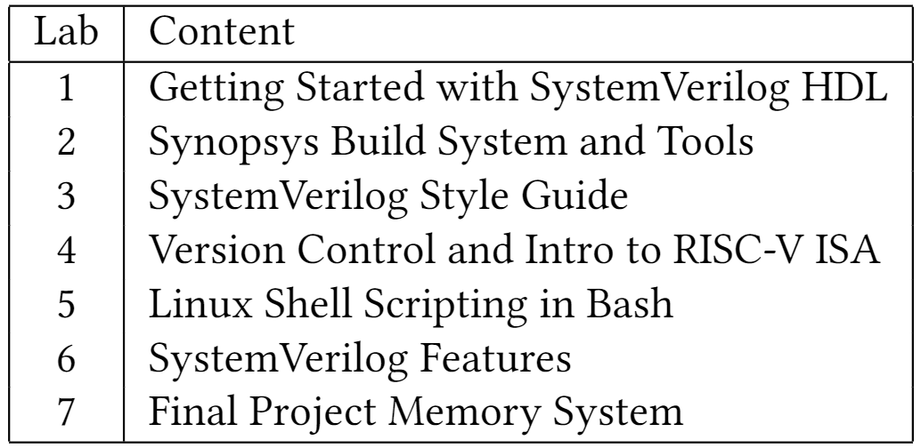
Class Overview
Seven labs
Five homeworks
Two exams
Three individual projects
Basic Verilog module
Finite state machine
In-order RISC-V pipeline
Final group project
Semester Timeline
Lecture:
OOO Algorithms and Implementations
Memory Systems and Caches
Special Topics
Coding:
Three Individual Projects
Group Project
Notes:
We have 7 labs in this class, teaching people essential skills such as writing Verilog and using EDA tools,. We go over version control and basic scripting. Most importantly we also go over the RISCV ISA that we will be using later in the class. We got 5 hw and 2 exams, 3 individual projects, first 2 of which gets people familiar in writing systemverilog, the last of which gets people onboard with riscv. Then we have final group project which takes up half of the semester

Slide 5
Final Project
OoO RISC-V 32-bit processor with branch prediction and L1 cache
Previously alpha64, updated to RV32IM
Written in SystemVerilog and synthesizable
Groups of 4-5 students over 8 weeks
Milestone 3
(optional)
Milestone 1
Milestone 2
Project Timeline
Week:
1-2
3-5
6-7
8
Goal:
First module and unit-test
OoO Pipeline
Cache and memory system
Integration and debugging
Notes:
For the final project, which is the biggest highlight of this class, we’ll have students will develop a 32bit RISC-V OoO processor. The class previously used alpha64, which if you’re born after the 90s you have probably never heard of, but we updated to use risc-v and will talk more about that in a bit.
The design will be in systemverilog, and has to be synthesizable
Students works in groups of 4-5 over 8 weeks with 3 milestones. Milestone 1 ends after 2 weeks in which students will write their first module and test it, then spend the next 3 weeks to complete the OoO pipeline for milestone 2. In week 6-7 they’ll work on caches and memory system with an optional milestone meeting, and eventually finish integration and debugging by week 8

Slide 6
Final Project
Provided with starter code of an in-order processor, also used for verification
Students will write almost all modules of the OoO pipeline and integrate them
Supports 40 instructions of RV32IM
Can support additional instructions via hardware emulation
Expected to add choices of advanced features to boost performance
Processors need to achieve correct output after executing testing programs
Evaluated on correctness and performance among peers
Notes:
We provide students with an in-order processor as starter code, in fact they’ll need to modify it as one of their individual projects. They can reuse anything from it, notably decoder, and they’ll use it to verify their own design. Students will still write almost all parts of the OoO pipeline and integrate them. Their cpu needs to support rv32im without the system calls and they’ll add advanced features., which we’ll talk about next, to improve performance. Their design need to correctly execute programs and evaluated on performance against their peers

Slide 7
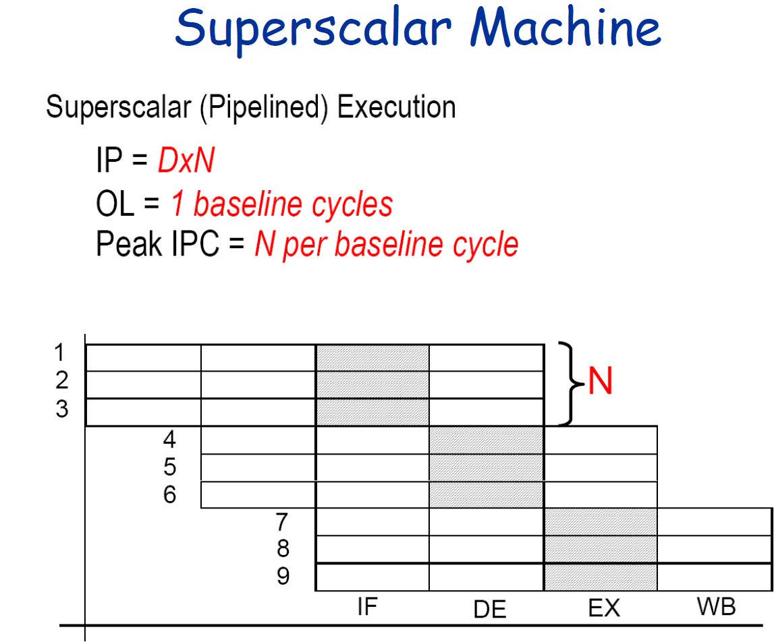
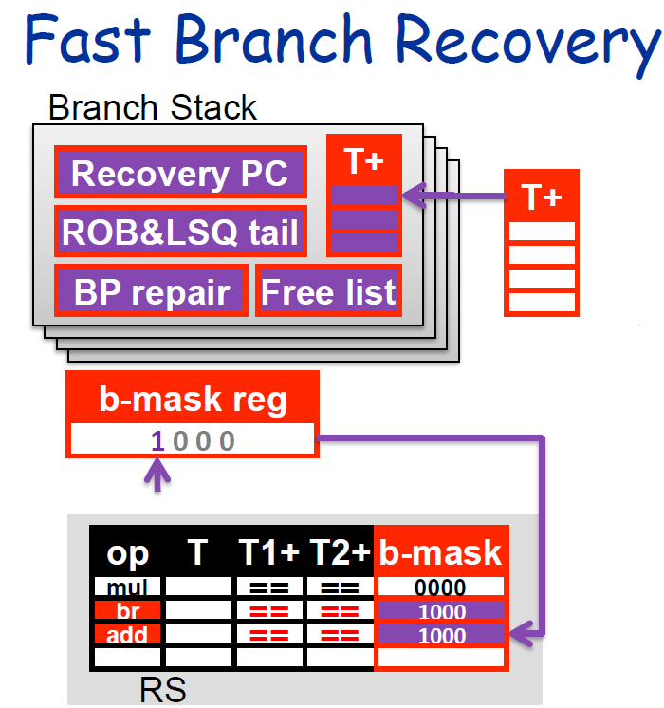
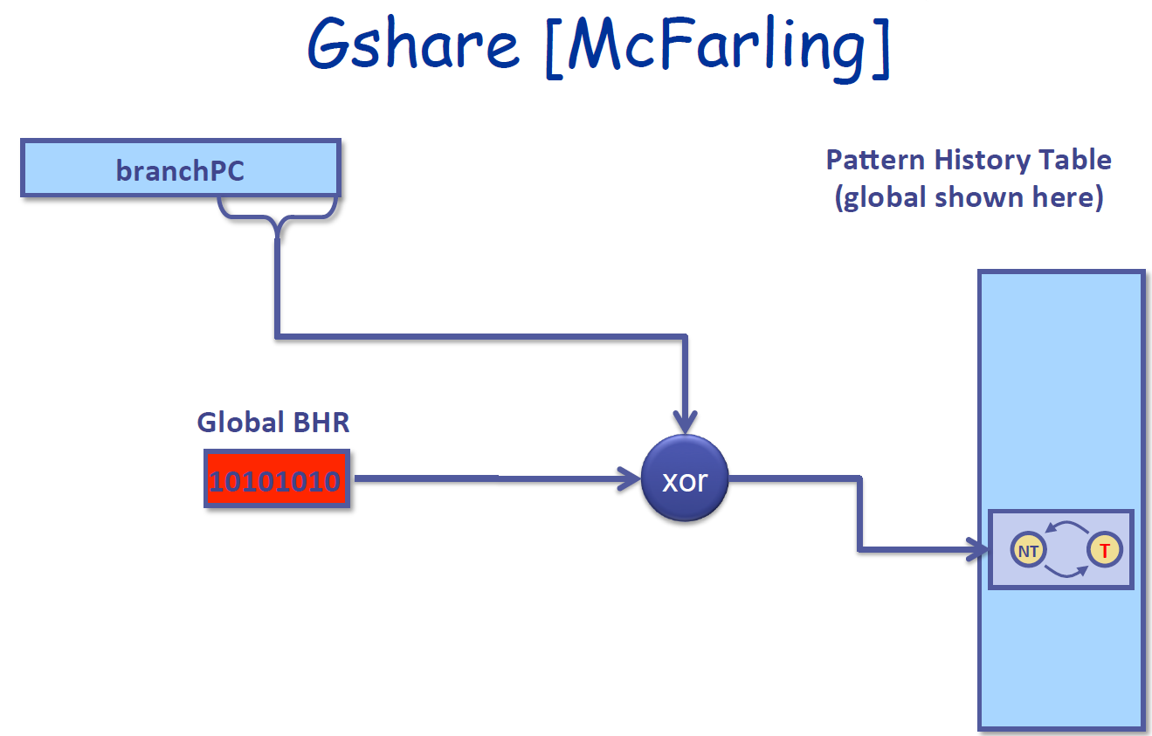
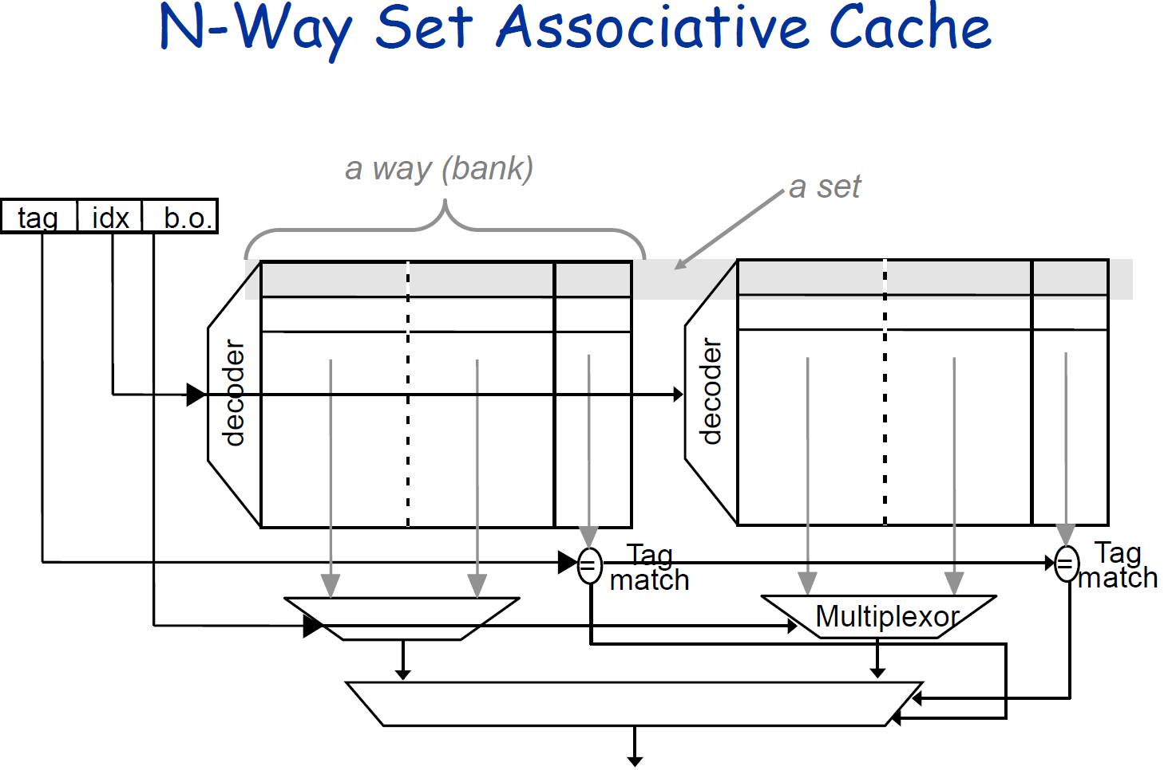
Common Advanced Features
Superscalar pipeline
Substantial performance boost
Incorporate from start
Cache enhancements
More associative cache
Load/Store Queue
Prefetching (simple is better!)
Early Branch Recovery
Advanced Branch Predictors
Notes:
These are some of the common features that students implement in their project. Many of these of are not that hard to do but offer very good performance gains like associative cache and simple stride prefetching. Some features like slightly better branch predictors such as gshare usually give limited returns, but are pretty easy to do and slap on. One feature that almost every single group does is superscalar pipeline, usually 2 or 3 way, which offers substantial performance boost and is what people’s top priority is. We also have complex features such as early branch recovery which gives good gains but is also hard to do, so it’s a bit less popular.

Slide 8
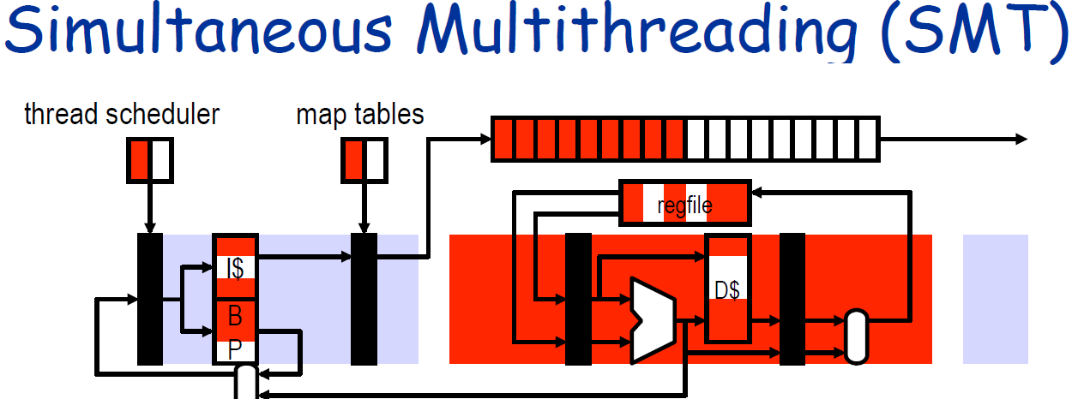
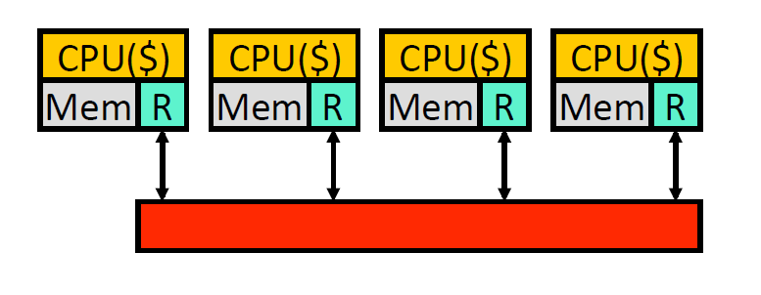
Niche Advanced Features
Multicore
Get simple core working fast
Figure out MSI protocol
Multithreading
Simple (maybe 2-way SS?) core
Dynamic resource allocation
Exceptions
Trap handling
Instruction emulation
Notes:
After the common features we have some niche features. We have multicore and smt for multithreaded workloads, students will have to implement a simple msi protocol and thread management respectively for each of these, as well as ll/sc. We also support exception handling which we use to emulate certain instruction like divide. Students will have to implement what’s needed for hardware trap handling. These features are very interesting but don’t really offer any performance gains that can be seen within our testing infrastructure, or any gain at all, and they can’t decoupled easily if they don’t work unlike something like a branch predictor which you can just not use. The reason we still offer these features, and why students do them occasionally, is that these are more relevant to modern designs and a very useful experience to have.

Slide 9
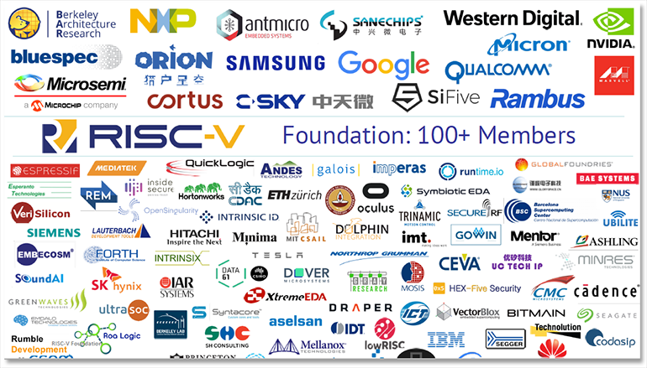
Why RISC-V?
Open source
Excellent software support
Industry adoption
Simple and modular
Leads to better full-stack understanding
Source: zdnet.com
Notes:
We like to use riscv for several reasons. The obvious are that it’s open source and gaining industry traction so that it’s more likely to be useful to students in the long run. It is simple and minimalistic. But the key thing here isn’t that what isa to teach in my opinion, high performance CPUs can be implemented on any isa, and we don’t really “teach” riscv that excessively, we just more or less use it. What really makes riscv shine is its excellent software support that can enable us to do certain, that we can use to tie together software and hardware which will get students to have a better understanding of the computing stack, and I’ll show you what that means

Slide 10
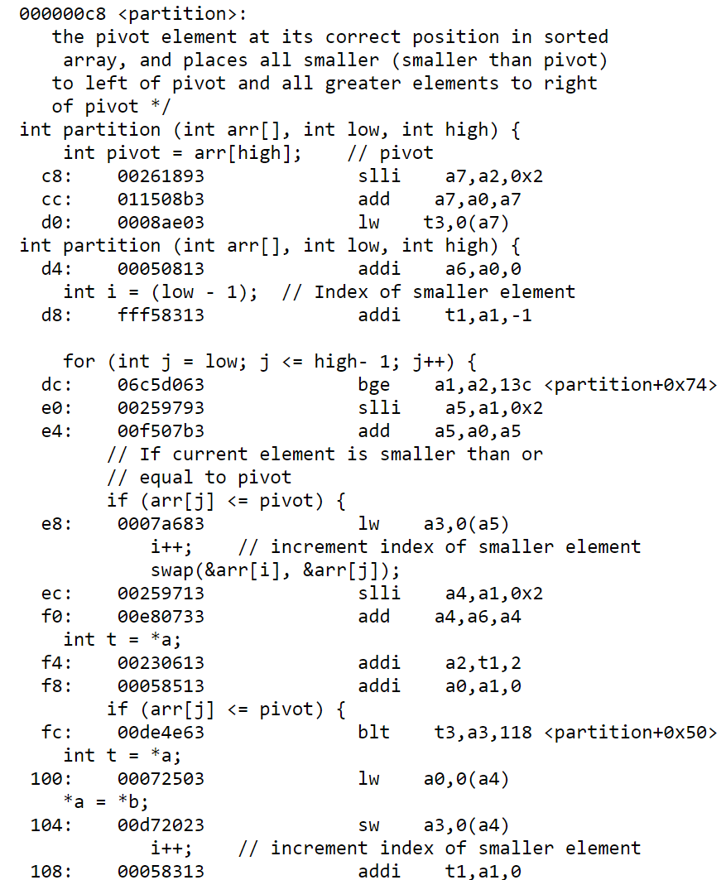
Compiler Support
We use GCC for test program compilation and binary tools for debugging
RISC-V supports the full GNU toolchain
Custom linker for memory allocation and custom runtime for initialization
Allows us to place entire programs within the project's memory space (64 KB)
Define boot behavior
Custom malloc() and free(), trap handler
Modular compilation
RISC-V supports compilation only using a subset of its ISA
RV32IM itself supports almost all C libraries
We can compile and run arbitrary programs
objdump of quicksort.c
Notes:
A really cool aspect of this class is that students get to run a lot of programs, including the ones they write, on the cpu that they designed. Test programs are compiled using gcc into riscv binaries. Since risc-v supports the full gnu toolchain we also get to use binary utilities for debugging. As you can see on the right, there’s the assembly of a compiled quicksort function. As a student, they get to see how a program is written, compiled and executed in hardware, which covers basically the full-stack of computing. To do this we had to create a custom linker and runtime to ensure proper memory placement and initialization. But all of this possible is possible thanks to the modular nature of risc-v, such that you can compile programs only using a subset. Rv32im supports almost all c libraries which means we can compile and run arbitrary programs, which means that with a permutation of 40 instructions, you can create almost any piece of software.

Slide 11
Testing Environment
Unit test for each module of the pipeline (required in the first milestone)
Assembly and C programs for processor level verification and performance evaluation
Originally only hand-written alpha64 assembly programs were supported
35+ test cases, constantly expanding by inclusion of student submitted test cases
Includes public and private cases
Basic | Functional | Typical | Performance
“Hello world” programs of simple instructions (<50 instructions) | Unpredictable branches and pointer chasing programs to verify specific functionalities (100 – 2,000 instructions) | Common data structures and algorithms in C, e.g. quick sort and linked-list traversal (5,000 – 20,000 instructions) | Large programs such as matrix multiplication and CPU simulations to measure performance (20,000 – 250,000 instructions)
Notes:
To test their designs, students will have unit tests for each of their modules, as required in the first milestone. Once they have a pipeline then they can run assembly and c programs. Note before the risc-v update we only supported hand-written assembly since there are no alpha compilers that can compile only using a subset of instructions. There are 35+ test cases, since we include student submitted cases every semester. Within this suite we have some basic ones that just see if anything can run at all, some corner cases to test functionality, some common data structures and algorithms such as quick sort to reflect real workloads, and some very large programs like matrix-multiplication that represent complex things like machine learning workload to measure performance. Most of the latter two types of programs are only possible thanks to risc-v. we can also generate different versions of the test cases by changing the optimization levels. There are both public and private test cases. A good example of a private case is actually one of the programming assignments from another class.

Slide 12
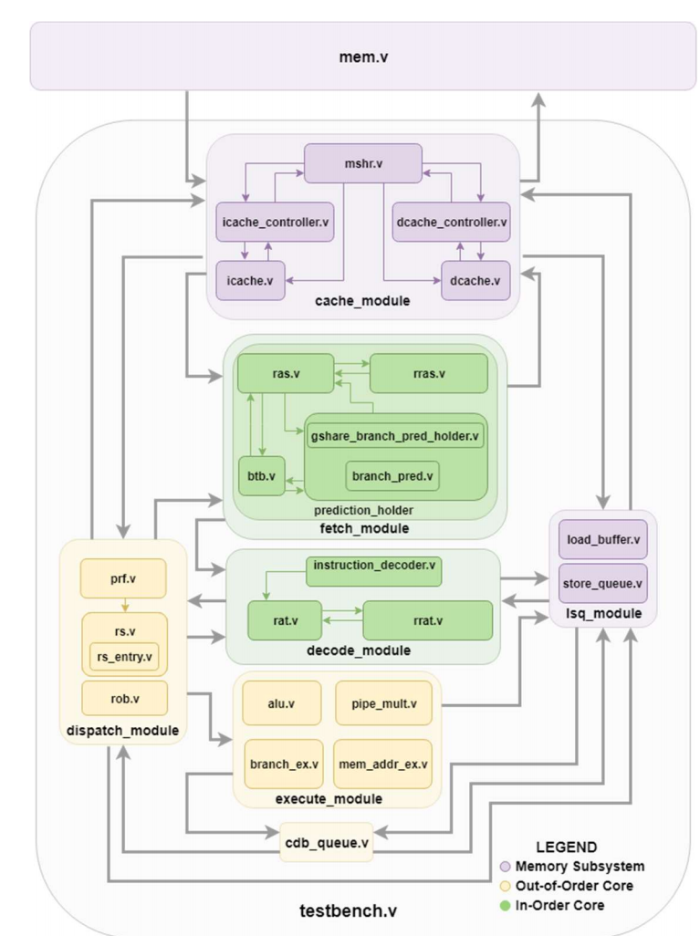
Project Summary
Student groups turn in:
OoO processor
Compile & run arbitrary RV32IM code using our platform
Roughly 3,500-5,000 lines of SystemVerilog
Test bench
Synthesis results
Optional test case(s)
Performance analysis
Grade on correctness and performance (runtime)
Functional diagram, Group 1 Winter ‘18
Notes:
At the end of semester, students will turn in a verified OoO core that can run basically any program, as long as it can be compiled into rv32im. It’ll take them to write about 4000 lines of verilog code to design the core. Their design also needs to synthesized such that it can be built into actual hardwar. They can also turn in an optional test case that we can include in the test suite. Students will analyze their performance and evaluate the impact of the features they added. We the instructors will grade based on correctness and performance measured by runtim.

Slide 13
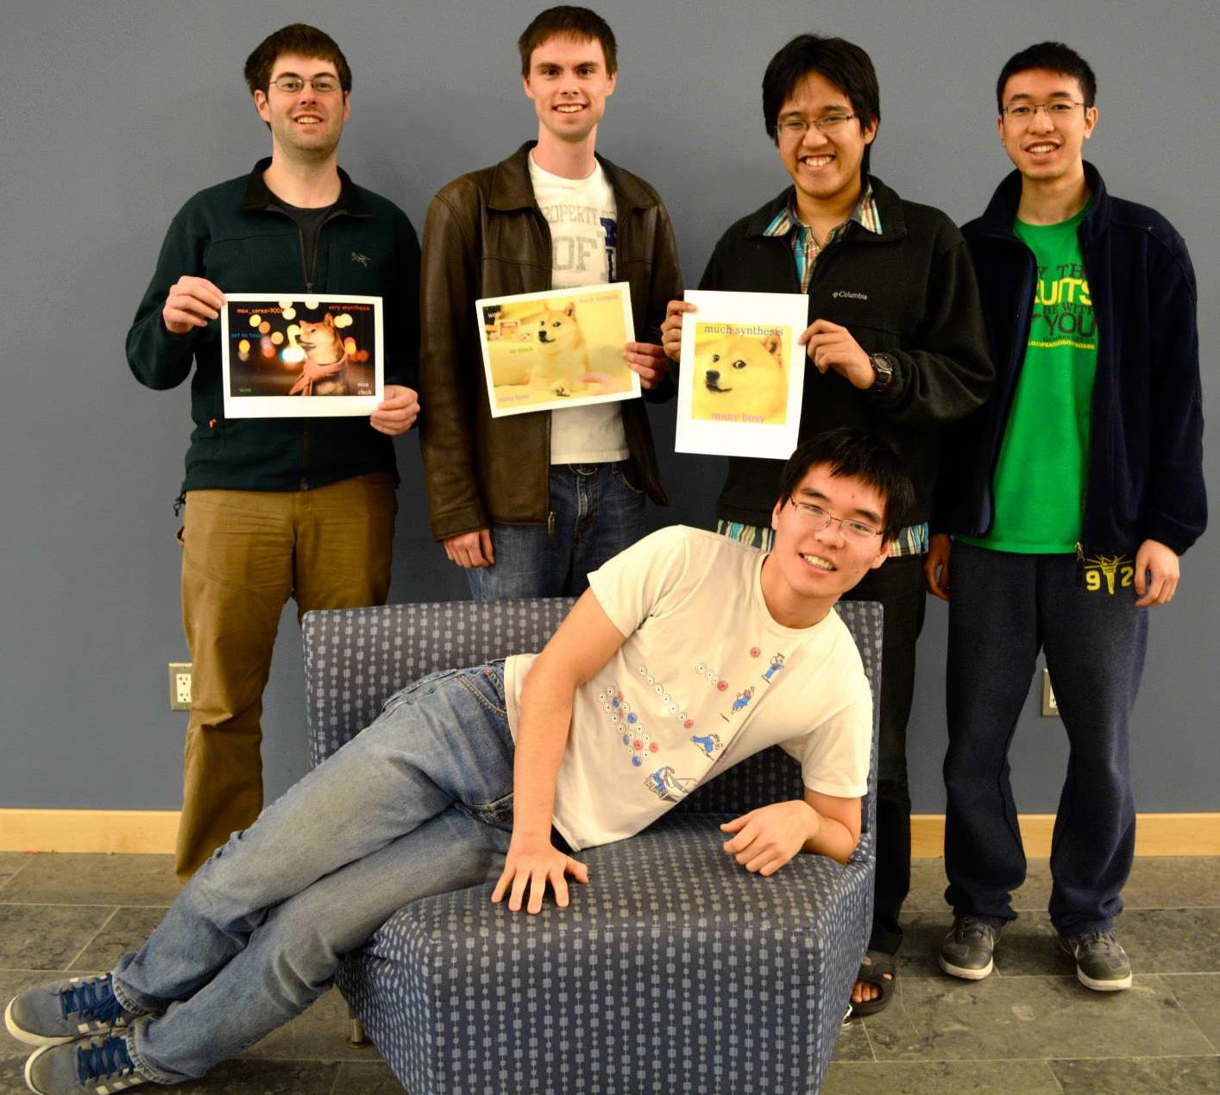
Conclusion
We teach modern computer architecture
Students design a RISC-V OoO core
RISC-V provides amazing tools to facilitate processor design
Compiler tools to support student groups
We have open-sourced our project and lab materials
https://github.com/jieltan/OpenCompArchCourse
Co-author Steve Zekany (left) with his project group circa 2014

Slide 14
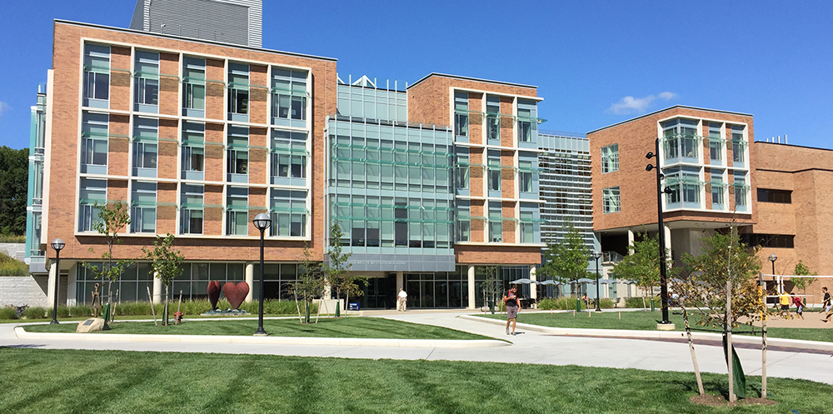
Thanks to everyone who helped along the way!
Austin Rovinski, who beta-tested the new project spec and tools
Siying Feng and Xueyang Liu, who TA'd the class after the course change
Jon Beaumont and Will Cunningham, who developed many of the materials
Tom Wenisch, Mark Brehob, and the other lecturers who taught the class over the years
The WCAE organizers, for their valuable time and comments
And finally: the students who participated in the project in Winter and Fall 2019, without whom none of this would be possible

